Slide 1
Data Processing System
Chapter-4

Slide 2
Data processing systems are computer systems with appropriate hardware components for the processing, storage and transfer of data, as well as software components for the management of hardware , peripheral devices and data.

Slide 3
Hardware and software trend
The trend allow us to look ahead into the future and to attempt a forecast of geo information processing may look like in 10 years from now.
The development of computer hardware at faster rate.
More powerful processors are generated almost every six month replacing older one and makes our computer an estimated 30% faster.
The power that we have available in today’s portable note book computes is a multiple of the performance that the first PC had when it was introduced in the early 1980’s
The trend in disk storage is towards greatly increased storage sizes for micro-computers, e.g. PC's and workstations, at a lower cost;
The emergence of relatively low cost , reliable raster output devices, in particular inexpensive ink jet based plotters, has replaced the more expensive color electrostatic as the ad hoc standard plotting device for GIS.;

Slide 4
The emergence of fast, relatively inexpensive micro-computers with competitive CPU power, e.g. 32-bit Penitum has challenged the traditional UNIX stronghold of GIS.;
While the de facto operating system standard has been UNIX , the Windows NT operating system is emerging as a serious and robust alternative. This is especially prevalent with organizations wishing to integrate their office computing environment with their GIS environment. This trend is closely associated with the development of 32-bit micro-computers.;
SQL (Standard Query Language) has become the standard interface for all relational DBMS;

Slide 5
Software technology develops somewhat slower and often
cannot function fully the possibilities offered by hardware, but existing software obviously performs better when run on faster computers.
Computers have become increasingly portable.
Hand held computers are now common in business and personal use.
Portable computers will be soon become common and cheap allowing field surveyors, for instance to take powerful computers into the field, possibly hooked up with GPS receivers for instantaneous geo-referencing.

Slide 6
Recently, major development is in computer networks.
We have arrived in an era where any computer can almost anywhere on Earth be hooked up onto some networks, and contact other computers virtually anywhere else.
This allows fast and reliable exchange of spatial data as well as computer programs to operate on them.

Slide 7
Hardware used for data input and output in GIS
Digitizers
Plotters
Scanner
Digitizers, plotters and scanners are designated based on the handling capacity of paper size. The different size of hardware commonly used are:
A0 size 34”X 46”
A1 size 22”X 34”
A2 size 17”X22”
A3 size 11”X17”
A4 size 8.5”X11”
If the scanner, printer, plotter or digitizer can handle A0 size sheet then the hardware is called A0 size scanner or printer, plotter, scanner or digitizer.
All the hardware are supplied with the driver operating CD to install the hardware devices.
There are many commercial brands of scanner, printer, plotter, digitizer available.

Slide 8
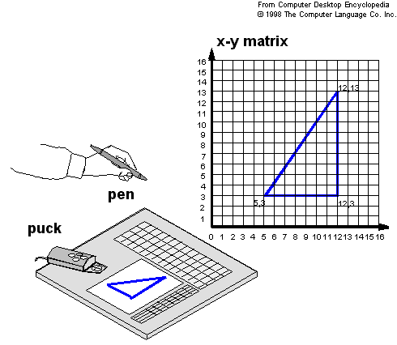
Digitizers
Digitizing Tablet is a common device for drawing, painting, or interactively selecting coordinate positions on an object.
A digitizing tablet consists of an electronic tablet and a cursor or pen (stylus).
A pen also called stylus looks like a simple ballpoint pen but uses an electronic head.
The tablet contains electronics that enable it to detect movement of the cursor.
For digitizing tablet each point on the tablets represents a point on the display screen.
Sonic tablets uses sound and microphone to detect the position of cursor.

Slide 9
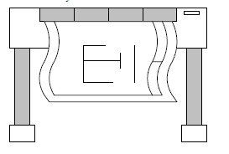
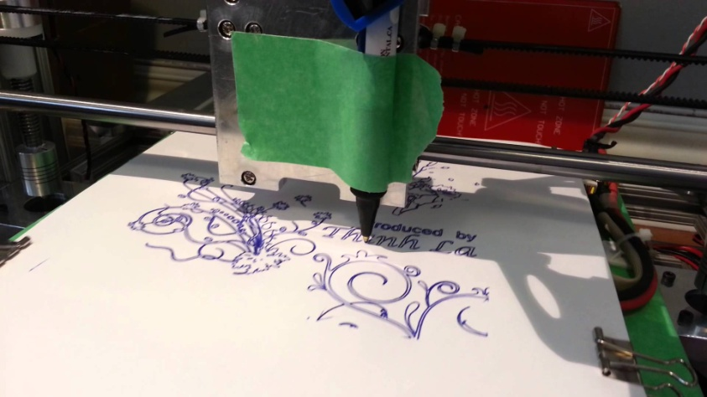
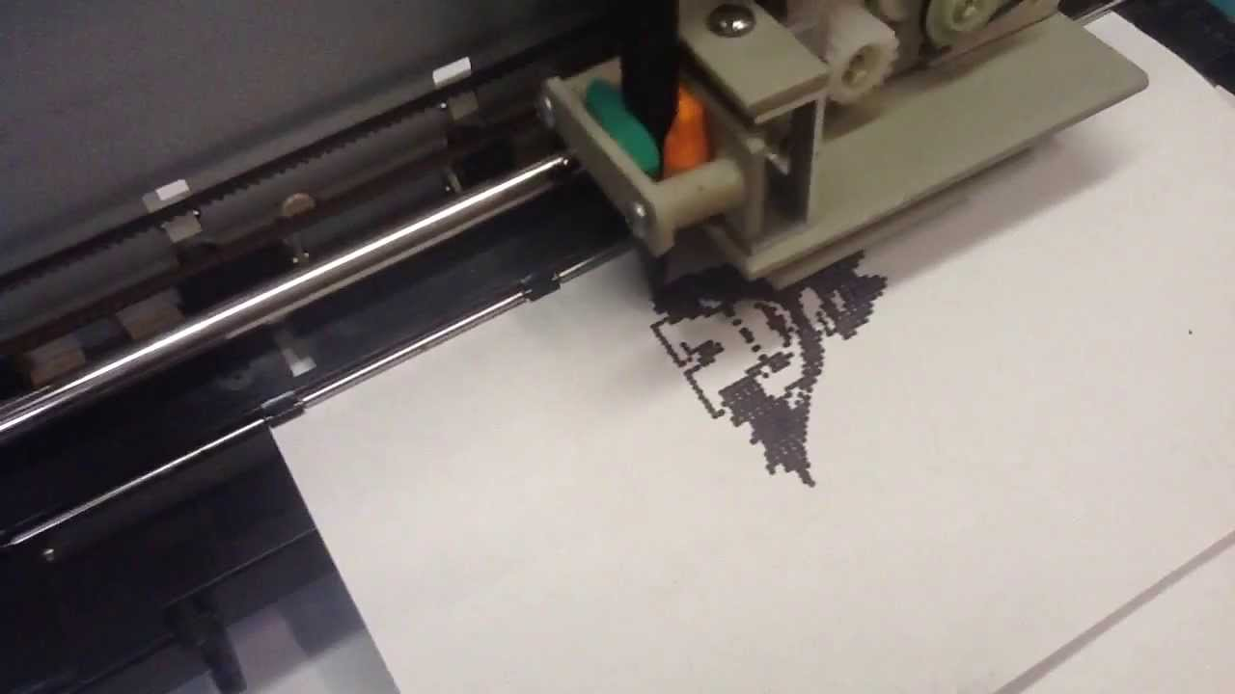
Plotters
Plotter is a device that draws pictures on paper based on commands from a computer.
Plotters differ from printers in that they draw lines using a pen.
As a result, they can produce continuous lines, where as printers can only simulate lines by printing a closely spaced series of dots.
Multicolor plotters use different-colored pens to draw different colors
In general, plotters are considerably more expensive than printers. They are used in engineering applications where precision is mandatory..

Slide 10
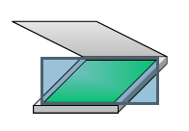
Scanners
A scanner is an input device that can read text or images printed on paper and translate the information into the form that the computer can use.
In other words a scanner copies an image, creates and stores it
on a computer disk in a form that can be used by the computer.
Scanning converts paper map into raster digital data.
A scanner works by digitizing an image- dividing it into a grid of boxes and representing each box with either zero or one, depending on whether the box is filled in.

Slide 11
It consists of 0 and 1.
0 is background and 1 is map feature.
For scanning a image, resolution of 300dpi(dot per inch) is required.
The scanner may be monochrome or color scanner and accordingly the image is scanned in black and white or color.
Black and white maps are scanned as 1 bit monochrome.

Slide 12
To obtain grayscale image, 8 bit adopted while 24 bit is used for color image.
To get 24 bit true color, scanner is done in 3 color(RGB).
Each color has 8 bit integer number with range of 0-255.
Roughly 24 bit color image can have 16.7 million colors.
Pixel depth are given as follows;
4bit 16 colors
8 bit 256 colors
16bit 32768 colors
24bit 16.7 million colors

Slide 13
Scanner will not enhance the quality of the output because the output is relied directly on the map source.
If the source map contain error then the error will be carried out in digital data also.
Quality of digital data depends upon source maps and effort taken by the operator to digitize the map accurately.
Paper maps are subjected to shrink and expand due to adverse effect of temperature and humidity which requires due care while scanning the maps which were already subjected to some level of distortion.

Slide 14
GIS SOFTWARES
The main characteristics a GIS software package are its analytical functions that provide mean for deriving new geoinformation from existing spatial and attribute data.
Depending on the interest of particular application, GIS can be considered to be a data store i.e a database that stores spatial data, a toolbox, a technology.
All GIS packages available on market have their strength and weakness.
Some GIS are focused to support raster manipulation, others more on vector based spatial object.
The package that supports for only raster or only object is not considered full fledged, generic GIS.
Some full fledged GIS packages are ILWIS , ArcINfo.

Slide 15
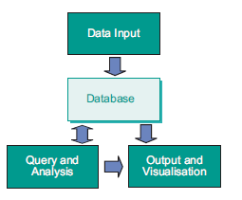
Software architecture and functionality of GIS
GIS in wider sense consists of software, data, people and an organization in which it functions.
In the narrow sense, we consider GIS as a software system for which we discuss its architecture and functional components.
According to the definitions, GIS consists of module for input, storage, analysis, display and output of spatial data.
Functional Component of GIS

Slide 16
Softwares
Arc GIS
Arc view
EDRAS
IDRISI
Cad core
R2V
ILWIS
ER mapper
Auto cad
Quantum GIS
Imagine orthomax

